Slide 1
FIU GPA Tracker and Forecaster 2.0
Team Members: Lizette Mendoza, Alex Sanchez
Product Owner: Johann Henao
Instructor: Masoud Sadjadi

Slide 2
About the GPA Tracker
Aid students to reach a target GPA goal before graduation
Unique: Student’s get to decide how well they want to do in some course over others
Weight: class difficulty level
Relevance: how well the Student wants to perform
Breaks down the goal into semesters – forecast reports
Keeps track of the Student’s performance throughout the semester – grades

Slide 3
Contributions
Lizette Mendoza
Semester GPA Forecast Report
Semester Assessment Views
Overall GPA Forecast Report
Migrate code to Object Oriented / AngularJS
Design the new look-and-feel
Alex Sanchez
Audit import
Error logging
Curriculum import
Admin interface
Migration to Object Oriented Design / AngularJS

Slide 4
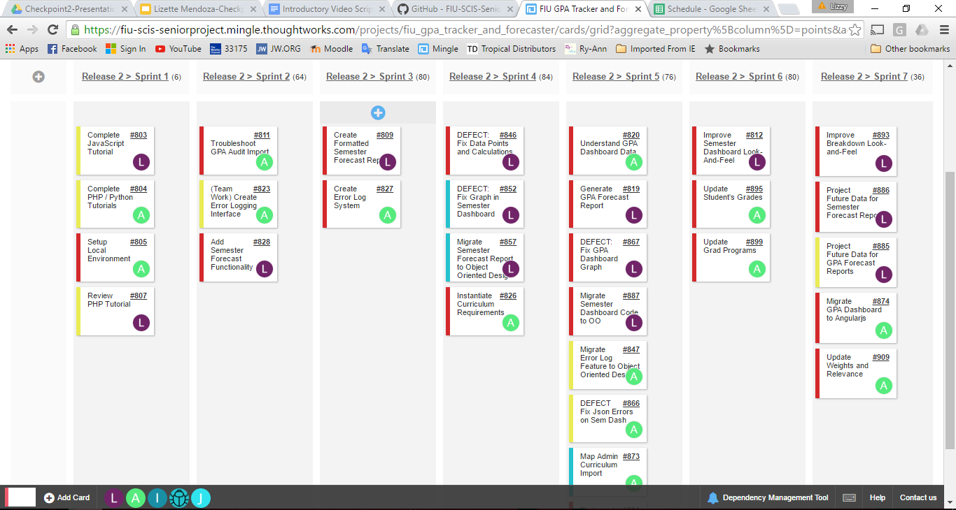
User Stories

Slide 5
User Stories (Cont.)
#828 Semester Forecast Functionality
#809 Create Formatted Semester Forecast Report
#846 DEFECT: Fix Data Not Aligning or Calculated Properly
#857 Migrate Semester Forecast Report to Object Oriented Design
#819 Generate GPA Forecast Report
#867 DEFECT: Fix GPA Forecast Report
#887 Migrate Semester Dashboard Code to OO
#812 Improve Semester Dashboard Look-And-Feel

Slide 6
User Stories (Cont.)
#809 Create Formatted Semester Forecast Report
Description:
As a student, I would like to generate a formatted report to allow me to view a printed report of that I need to achieve for the current semester.
Acceptance Criteria:
Generate Forecast Report from the Semester Dashboard.
A new HTML page will be open with a printed report.
Student should see a table of information to reach their semester goal.
Report includes a Semester Assessments graph.

Slide 7
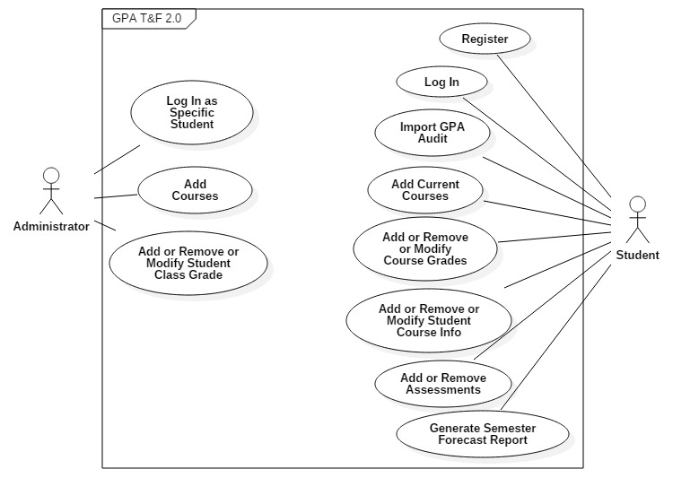
Use Case Model

Slide 8
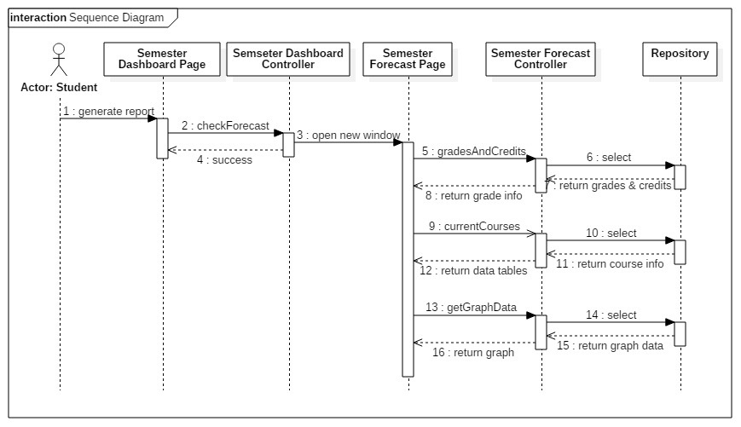
Sequence Diagram

Slide 9
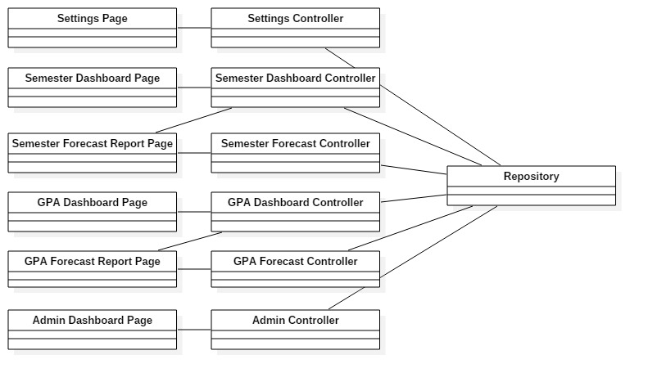
Class Diagram

Slide 10
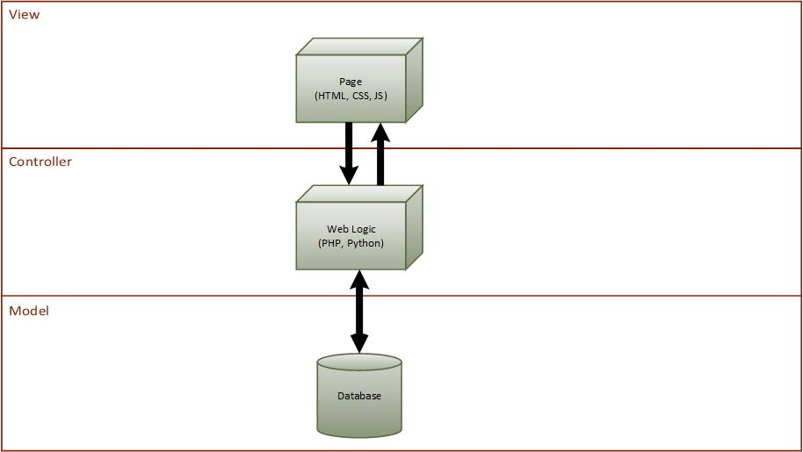
Architecture

Slide 11
Persistent Data Management

Slide 12
Security / Privacy
All passwords are encrypted
All failed attempts are logged

Slide 13
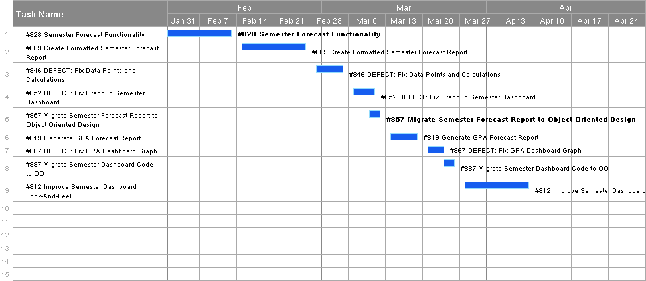
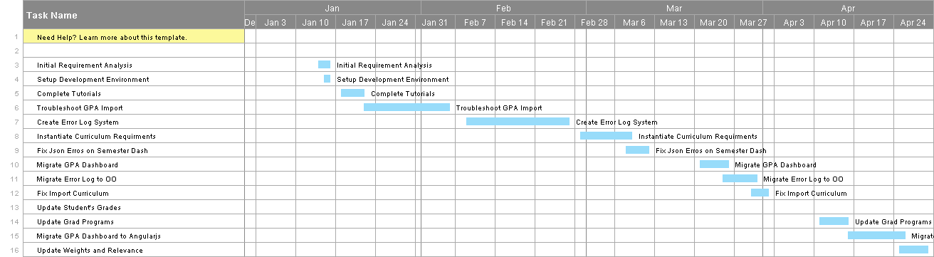
Gantt Charts

